Slide 1
Introduction to Operating Systems
Notes:
What is an OS?
How did OS evolve?
What are the major OS functions?
… lets understand these by looking at specific actions
Consider “access control”
How is user access to OS functions controlled?
How is user interaction managed or implemented?
How is device interfacing managed or implemented?
Consider “resources”
What are the resources managed? CPU time, memory, storage
What is the primary receptor? Process
Consider “programming”
Concurrency
Threads/processes
Inter-process communication
How can we package these functions in an OS?
What are the architectural solutions?

Slide 2


What is an Operating System?
Trusted software interposed between the hardware and application/utilities to improve efficiency and usability
  Most computing systems have some form of operating systems
  Hard to use computer systems without OS
Applications & Utilities
Operating System
Computer Hardware
Notes:
Grand Tour of Operating Systems (50 slides)
Introduction to OS – What is an OS? (2)
OS Evolution/history (3)
OS functions (38)
* access control (10)
* user access
* device access
* resource management (20)
* process (8)
* memory (6)
* storage (6)
* programming model (8)
* process/threads
* inter-process communication
* concurrency
OS architectures (7)

Slide 3
How did OS evolve?
In the beginning….
  Computers cost millions of $$
  Hard to operate (done using console switches)
  Hard to program – particularly device I/O

Slide 4
How did OS evolve?
Expensive machines cannot idle... utilization should be very high
  Batch processing was devised
  Programming done offline and subroutine were created for common tasks
  I/O and processing overlap obtained via buffering and interrupts

Slide 5
How did OS evolve?
OS evolution was driven by two important factors:
  Cost of Computers (i.e., computer time)
  Cost of People (i.e., user time)
early batch
systems
time sharing
systems
computer utilization
personal
systems
user wait time

Slide 6
What are the design concerns?
Systems | Design Concerns
Personal/Embedded systems (e.g., PDAs)
Time-sharing systems (e.g., Lab workstations)
Batch systems (e.g., IBM mainframes, supercomputers)

Slide 7
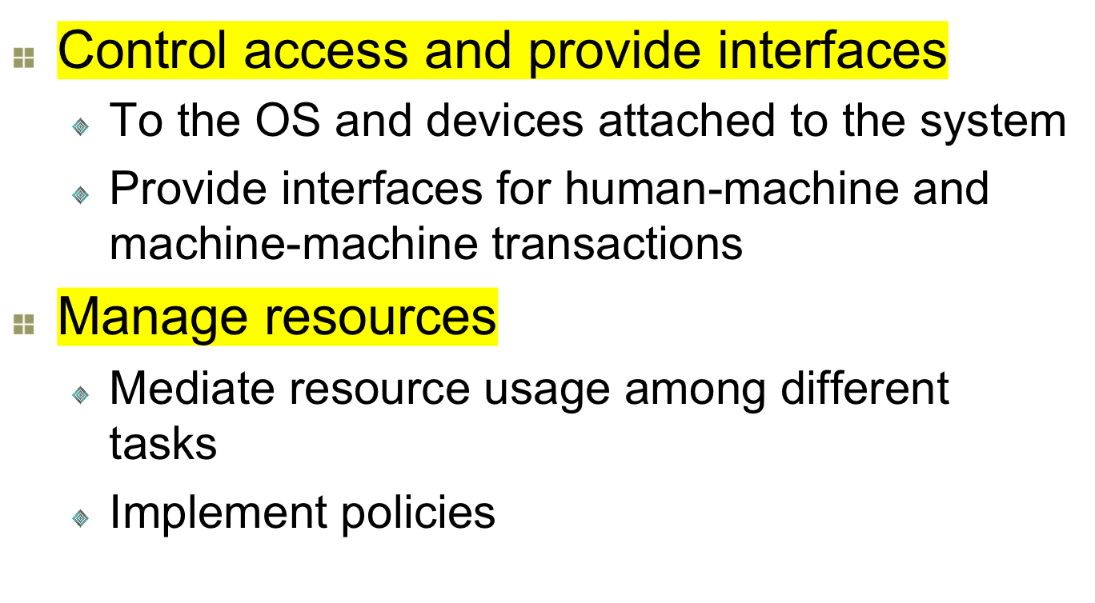
What are the major OS functions?

Slide 8
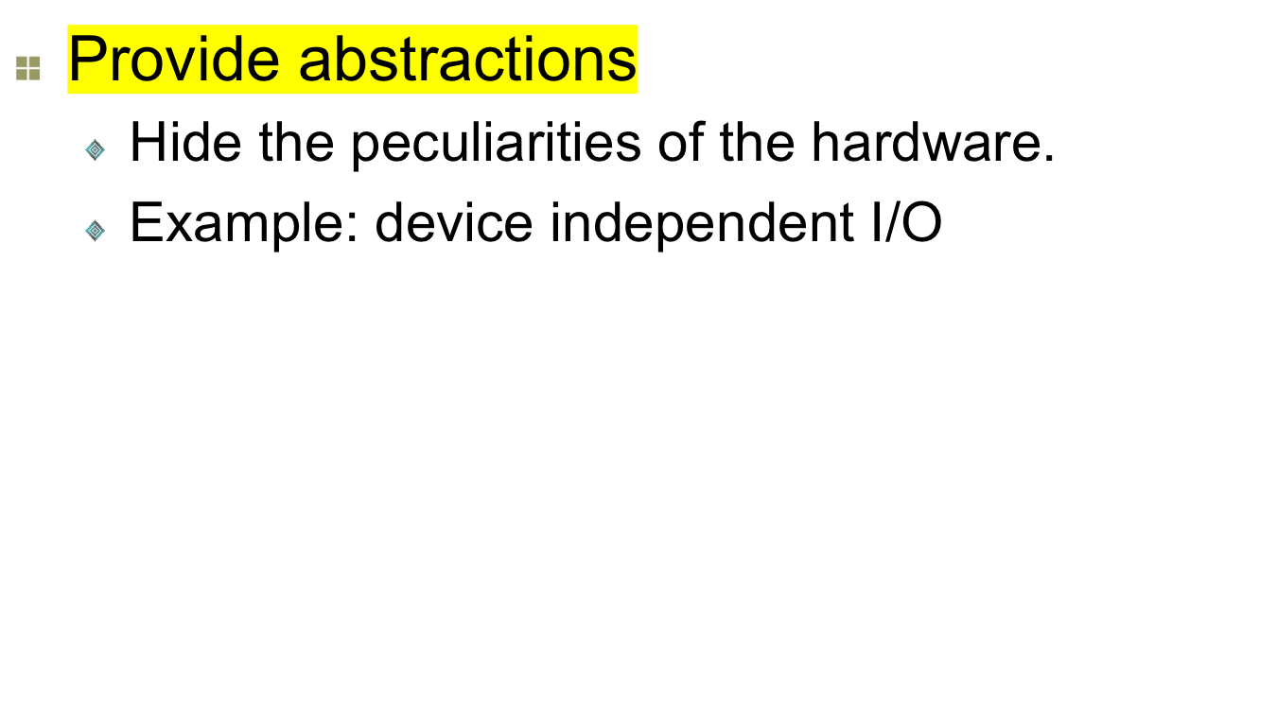
What are the major OS functions?

Slide 9
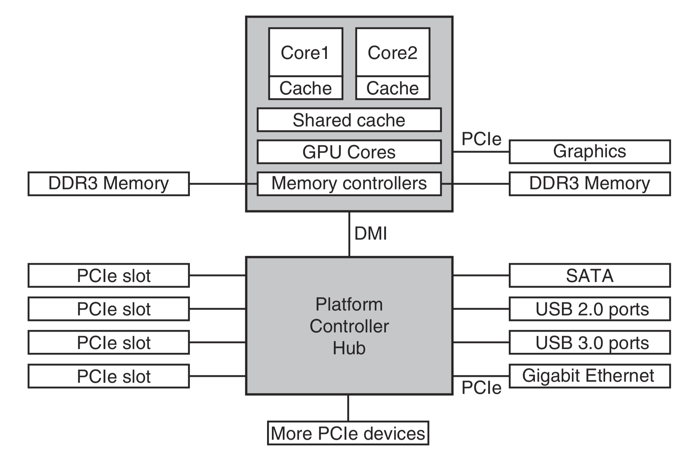
Computer organization

Slide 10
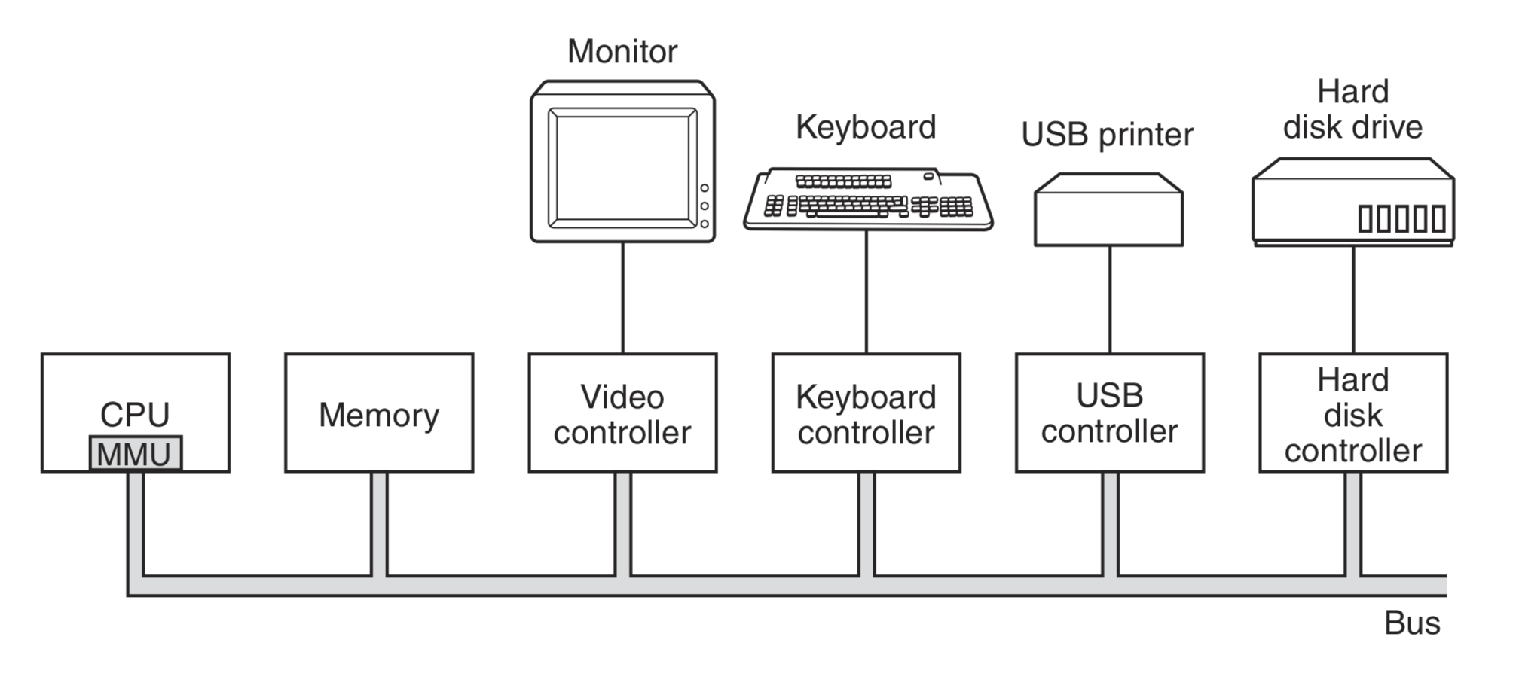
Booting up a computer

Slide 11
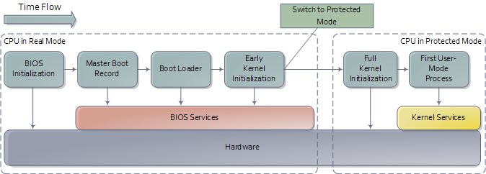
Booting up a UNIX-like OS

Slide 12







How does OS manage resources?
Recipients of the
Resources
Resource Manager
(Operating System)
(Processes – represent
applications)
Resources

Slide 13
Process: Avatar of the application
A process represented process table entry
Pointer to text segment
Pointer to data segment
Pointer to bss (uninit. data) segment
Signal status
Process ID
Parent process
Process group
Real uid
Real gid
Effective uid
Effective gid
Bit maps for signals
Various flag bits
UMASK mask
Root directory
Working directory
File descriptors
Effective uid
Effective gid
System call parameters
Various flag bits
Registers
Program counter
Program status word
Stack pointer
Process state
Time when process started
CPU time used
Children’s CPU time
Time of next alarm
Message queue pointers
Process ID
Various flag bits
Memory management
File management
Process management

Slide 14
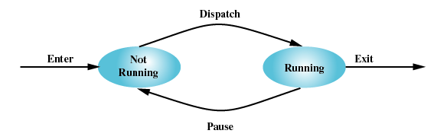
A simple process model
Below is a two-state process model
  Running (on the CPU)
  Not running (waiting to get the CPU or at I/O)
Process creation
Process termination

Slide 15
Process scheduling
process
2
process
1
process
n
CPU
Operating
System
dispatcher
Ready Queue

Slide 16
Why multiple processes?
Single job (process) cannot keep CPU and I/O devices busy at all times
Multiprogramming organizes jobs (code and data) so CPU always has one to execute
A subset of total jobs in system is kept in memory
One job selected and run via job scheduling
When it has to wait (for I/O for example), OS switches to another job
Notes:
Operating system can be designed depending on the use case of the computer.
In the early days of computing, computing systems were very expensive.
So only universities, government funded agencies, or big corporations had access to these machines.
Because the machines were expensive they had to kept busy all the time. So the applications (mostly simulations)
were organized into batches of jobs and were fed into the computer one after the other.
The job scheduler was responsible for figuring out the sequence in which the jobs should get executed.

Slide 17


Why memory management?
For multiprogramming:
  multiple programs should co-exist in the memory
  If programs don’t co-exist (share the memory space) what will happen?
With memory space sharing:
  necessary to protect co-residing programs from each other
  depending on the occupancy pattern, a program would not know the location until load time

Slide 18
Why is memory management?
It provides:
  Protection
  Relocation

Slide 19
How does OS manage memory?
Idea:
  Divide the memory into partitions and allocate them to different processes
  Partitions can be fixed size or variable size
A process
  Cannot access memory not allocated to it
  Can request more memory from OS
  Can release already held memory to OS
  May only use a small portion of the allocated memory

Slide 20
How does OS manage memory?
We can load more processes than that fitting the memory
Where do the rest go? Answer: Virtual memory

Slide 21
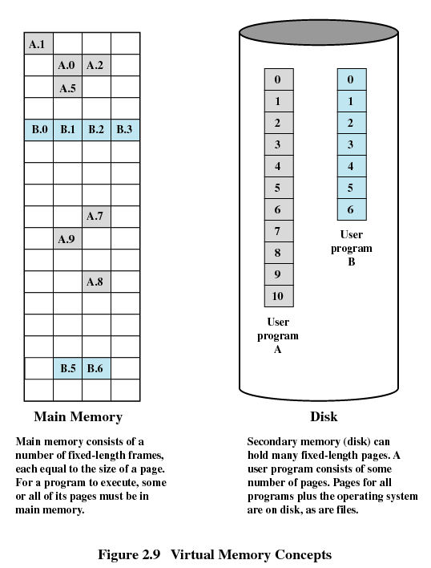

Virtual memory in action
Some memory chunks (pages) are in memory
Rest in disk
OS is responsible for retrieving the pages from and flushing the pages to disk

Slide 22
Storage management: overview
Requirement:
  Need to store data in persistent store
  Organize the data such that it is easy to access and is protected
What are the challenges?
  Performance: secondary storage such as disks are very slow
  Handle heterogeneity
  Protect devices

Slide 23
Storage management: Data view
dir21:
file21.1
file21.2
file21.3
dir22:
file22.1
file22.2
file22.3
dir23:
file23.1
file23.2
file23.3
01010
10101
10100
10101
10101
10101
10101
10100
10101
01011
10101
10101
10101
USER
FILE SYSTEM
DISK SYSTEM
File system based
view – content visible
as files and directories
Block based view
content considered as
blocks of data
Physical view –
all data just a stream
of bits

Slide 24
Abstractions provided by the OS
Central to the abstractions provided by OS is
  Processes or
  Threads (lightweight processes)
What are the functions provided for process?
  Lifecycle management
  Resource management
  Inter-process communication

Slide 25
What is inter-process comm.?
Processes:
  Compete with one another for resources
  Sometimes they also cooperate to get an application done! Can you give an example?
Inter-process communication:
  Key for cooperating processes that depend on each other

Slide 26
How to do inter-process comm.?
We can use two approaches:
  Shared memory approach:
  Message passing approach

Slide 27
OS & Interrupts
Hardware interrupt by one of the devices
Software interrupt (exception or trap):
  Software error (e.g., division by zero)
  Request for operating system service
  Other process problems include infinite loop, processes modifying each other or the operating system
Notes:
The OS operations are interrupt driven.
The most common situation is the clock interrupt used for the time slicing purposes.
As we saw previously, other interrupts are also used in the operation of the OS.
For example, devices interrupt the OS to gain its attention. After gaining the OS’s attention the
device could ask the OS to perform a certain task for it.
In addition to the hardware generated interrupts, we can have software generated interrupts.
These interrupts are used to that the OS can react to situations that it did not anticipate.
For example, a software error could arise due to division by zero type of situations.
The OS needs to be engaged in remedying the situation.

Slide 28
Dual-Mode OS Operation
Dual-mode operation allows OS to protect itself and other system components
  User mode and kernel mode
  Mode bit provided by hardware
    Provides ability to distinguish when system is running user code or kernel code
    Some instructions designated as privileged, only executable in kernel mode
    System call changes mode to kernel, return from call resets it to user
Notes:
Modern Operating systems operate in dual mode: user mode and kernel mode.
Kernel mode is where it executes the kernel code that is supplied by the OS vendor.
The assumption is that this code is trusted and is highly reliable.
The processor has special privilege management schemes that will ensure no
user code can run in the kernel mode.
With the introduction of virtual machines, we are going into multi-mode operations from
the dual-mode situations.

Slide 29
UNIX
UNIX – limited by hardware functionality, the original UNIX operating system had limited structuring.
  Systems programs
  Kernel
    Consists of everything below the system-call interface and above the physical hardware
    Provides the file system, CPU scheduling, memory management, and other operating-system functions; a large number of functions for one level

Slide 30

UNIX Structure

Slide 31
How system call is processed?
system
call
table
User
Program
open()
system
call
entry
.
.
.
1
2
read()
.
.
.
3
read()
5
4
write()
system
call
exit
1. system service is requested (system call)
system
call
routines
2. switch mode; verify arguments and service
3. branch to the service function via system call table
4. return from service function; switch mode
Operating
System
5. return from system call
Notes:
Here is another situation where we use the dual mode operation of the operating system.
Suppose you want to read from a file. You issue the read() function call from your application code.
The read() function call is a special function called a “system call”. This is a call into OS provided
functionality.
The system call function would run some OS provided code to organize the input properly
and check it for validity.
Use a system call table to figure out the actual code that should be executed to carry out the read.

Slide 32
What are possible OS architectures?
How do we build an OS that has all the above functions?
  UNIX like – monolithic – throw everything into one pile and call it layered!
  Something more structured..

Slide 33
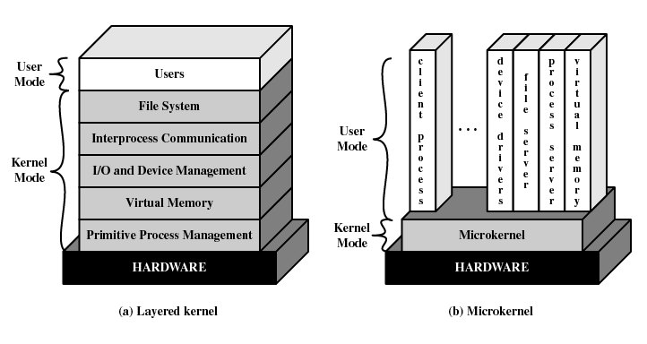
Layered Vs Microkernel

Slide 34

With and without virtual machines

